Slide 1
Geometric Transformation

Slide 2
Transformation
3D Primitives
Model Transformation
Transform into 3D World Coordinate System
Illustrate According to
Lighting and Reflectance
Lighting
Viewing Transformation
Transform into 3D Viewing Coordinate System
Projection Transformation
Transform into 2D Viewing Coordinate System
Clipping
Clip Primitives outside Window’s View
Viewport Transformation
Transform into Viewport
Scan Conversion
Draw Pixels
Image

Slide 3
Transformation
P(x, y, z)
3D Object Coordinate
3D Viewing Coordinate
Model Transformation
3D World Coordinate
Viewing Transformation
3D Viewing Coordinate
Projection Transformation
3D Object Coordinate
2D Projection Coordinate
Viewport Transformation
3D World Coordinate
2D Device Coordinate
p(x’, y’) or p(u, v)

Slide 4
Contents
Translation
Scaling
Rotation
Other Transformations
Coordinate Transformations
OpenGL Transformations

Slide 5
Transformation in 3D
Transformation matrix
1×4
3×3 : Scaling, Reflection, Shearing, Rotation
3×1 : Translation
1×4 : Homogeneous Representation

Slide 6
3D Translation
y
x
z

Slide 7
3D Scaling
y
x
z

Slide 8
Fixed-point Scaling
y
y
y
y
z
x
z
x
z
x
z
x
Original Position
Translation
Scaling
Inverse Translation

Slide 9
3D Rotation
Coordinate-axes rotations
x-axis rotation
y-axis rotation
z-axis rotation
General 3D rotations
Rotation about an axis that is parallel to one of the coordinate axes
Rotation about an arbitrary axis

Slide 10
Coordinate-axes Rotations
z-Axis Rotation
x-Axis Rotation
y-Axis Rotation
y
y
y
x
x
x
z
z
z

Slide 11
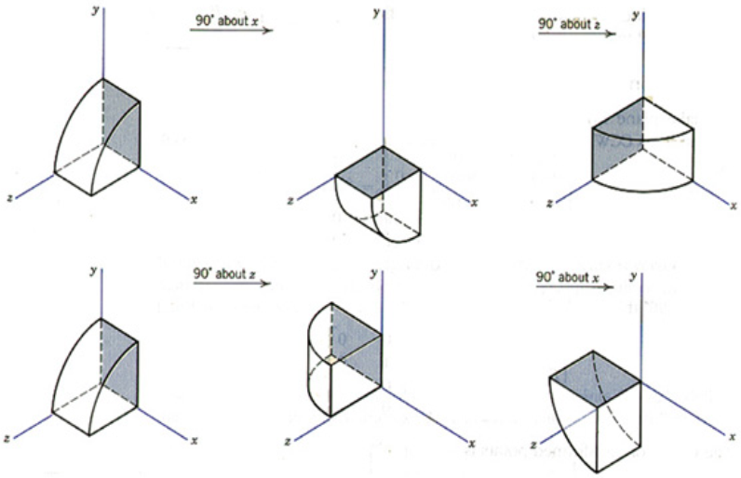
Order of Rotations
Order of rotations affects final position

Slide 12
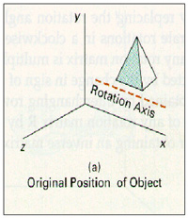
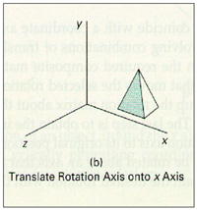
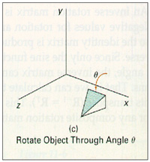
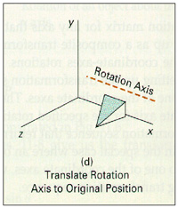
General 3D Rotations
Rotation about an axis that is parallel to one of the coordinate axes

Slide 13
General 3D Rotations
Rotation about an arbitrary axis
Basic Idea
Translate (x₁, y₁, z₁) to the origin
Rotate (x’₂, y’₂, z’₂) on to the z axis
Rotate the object around the z-axis
Rotate the axis to the original orientation
Translate the rotation axis to the original position
y
(x₂, y₂, z₂)
T
R
(x₁, y₁, z₁)
R
R⁻¹
x
T⁻¹
z

Slide 14
General 3D Rotations
Step 1. Translate
y
(x₂, y₂, z₂)
(x₁, y₁, z₁)
x
z

Slide 15
General 3D Rotations
Step 2. Rotate about x axis by α
y
(0, b, c)
(a, b, c)
Projected
Point
α
α
x
Rotated
Point
z

Slide 16
Arbitrary Axis Rotation
Step 3. Rotate about y axis by β (clockwise)
y
Projected
Point
d
β
x
(a,0,d)
z
Rotated
Point

Slide 17
Arbitrary Axis Rotation
Step 4. Rotate about z axis by the angle θ
y
l
θ
x
z

Slide 18
Arbitrary Axis Rotation
Step 5. Reverse transformation
To place the axis back in its initial position
y
l
l
x
z

Slide 19
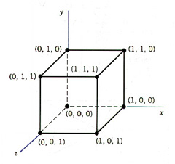
Example
Find the new coordinates of a unit cube 90º-rotated about an axis defined by its endpoints A(2, 1, 0) and B(3, 3, 1).
A Unit Cube

Slide 20
Example
Step1. Translate point A to the origin
T(-2, -1, 0)
y
B’(1, 2, 1)
A’(0, 0, 0)
x
z

Slide 21
Example
Step 2. Rotate axis A’B’ about the x axis by α
Until it lies on the xz plane
y
(0, 2, 1)
B’(1, 2, 1)
l
α
x
B”(1, 0, )
z

Slide 22
Example
Step 3. Rotate axis A’B’’ about the y axis by β
Until it coincides with the z axis
y
l
x
β
(0, 0, √6)
B”(1, 0, )
z

Slide 23
Example
Step 4. Rotate the cube 90° about the z axis
Finally, the concatenated rotation matrix about the arbitrary axis AB becomes,

Slide 24
Example

Slide 25
Example
Multiplying R(θ) by the point matrix of the original cube

Slide 26
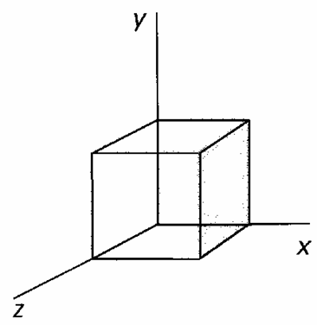
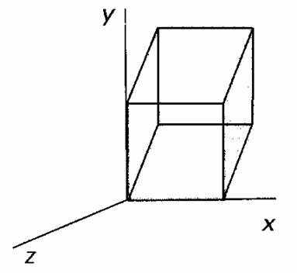
Other Transformations
Reflection to the xy plane
z-axis shear
y
y
(a, b, c)
(a, b, -c)
z
x
z
x

Slide 27
Coordinate Transformations
Coordinate systems
Local (modeling) coordinate
World coordinate
Scene
<Local Coordinate System>

Slide 28
Coordinate Transformations
Coordinate systems
Local (modeling) coordinate
World coordinate
Scene
<Word Coordinate System>

Slide 29
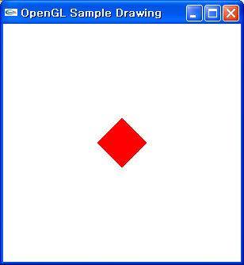
OpenGL Transformations
void glRotatef(GLfloat angle, GLfloat x, GLfloat y, GLfloat z)
glMatrixMode(GL_MODELVIEW);
glLoadIdentity();
glRotatef(45.0, 0.0, 0.0, 1.0);
glutSolidCube(0.3);

Slide 30
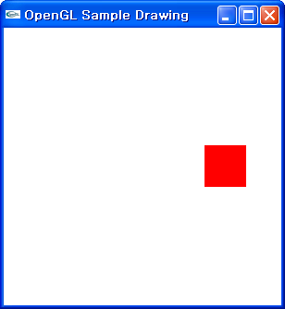
OpenGL Transformations
void glTranslatef(GLfloat dx, GLfloat dy, GLfloat dz)
glMatrixMode(GL_MODELVIEW);
glLoadIdentity();
glTranslatef(0.5, -0.5, 0.0);
glutSolidCube(0.3);

Slide 31
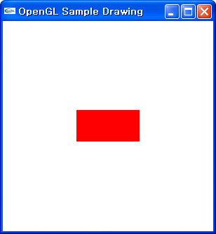
OpenGL Transformations
void glScalef(GLfloat sx, GLfloat sy, GLfloat sz)
glMatrixMode(GL_MODELVIEW);
glLoadIdentity();
glScalef(2.0, 1.0, 1.0);
glutSolidCube(0.3);

Slide 32
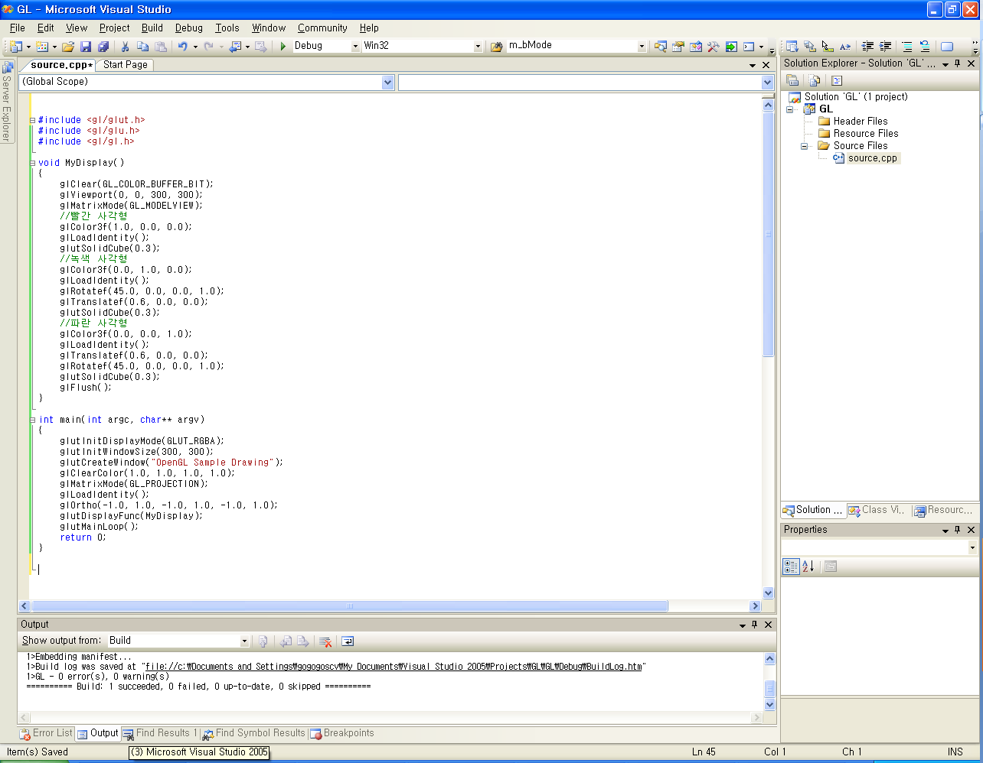
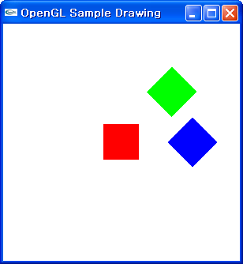
OpenGL Transformations
OpenGL Transformation Sample

